Slide 1
Review
Requirements is critical for successful software
Requirements = services the system is expected to provide + constraints placed on the system.
Two type requirements
  Functional and non-functional requirements
SRS: software requirements specification

Slide 2
Chapter 6
Requirements Engineering Processes

Slide 3
Objectives
To describe the principal requirements engineering activities and their relationships
To introduce techniques for requirements elicitation and analysis
To describe requirements validation and the role of requirements reviews

Slide 4
Topics covered
Feasibility studies
Requirements elicitation and analysis
Requirements validation
Requirements management

Slide 5
Requirements engineering processes
The processes used for RE vary widely depending on the application domain, the people involved and the organisation developing the requirements.
However, there are a number of generic activities common to all processes
  Feasibility study
  Requirements elicitation;
  Requirements analysis;
  Requirements validation;
  Requirements management.

Slide 6
Feasibility studies
For all new systems, the RE should start with a feasibility study:
Goal: Feasibility report suggests continue or stop the system

Slide 7
Feasibility studies (continued)
What: A short focused study that checks
  If the system contributes to organisational vision;
  If the system can be engineered using current technology and within budget;
  If the system can be integrated with other systems that are used.
In fact, it is a significantly compressed analysis and design process. It should be completed in a short time.

Slide 8
Elicitation and analysis
Requirements gathering, or discovering
How: communication
technical staff working with customers to find out about the application domain, the services that the system should provide and the system’s operational constraints.
Stakeholders involved:
end-users, managers, engineers involved in maintenance, domain experts, trade unions, etc.
Stakeholder is any one or organization who either affects the system development or is affected by it

Slide 9
Problems of requirements elicitation/analysis
信息不对称，交流困难
The curse of knowledge ¹
  is a cognitive bias according to which better-informed people find it extremely difficult to think about problems from the perspective of lesser-informed people. The term was coined by Robin Hogarth
  The Curse of Knowledge — The More You Know, the Worse You Become At Communicating That Knowledge
Notes:
需求的一个启发障碍是知识的诅咒（Curse of Knowledge），意思是：一旦知道某个东西，就很
难想像不知道它会是什么样子。1990 年，斯坦福大学研究生ElizabethNewton 做了一个著名的心理
学实验：让敲击者在桌子上敲击最常见的歌曲，听众根据听到的节奏回答是什么歌曲，然后让敲击者
估计听众答对了多少。120 次的实验中，敲击者预测听众猜对的比率会大于50%，真实的结果是听众
猜对的比率只有2.5%。因为听众听的是敲出来的声音，敲击者听的是大脑里已有的歌曲。
知识的诅咒在需求启发中体现为沟通的困难。

Slide 10
许多时候，开发人员把需求启发想得太容易。经常可以听到“采集需求”这样的表述，好像需求是蘑菇，乖乖地躺在森林里，开发人员需要时，就像采蘑菇的小姑娘一样，一个，两个，三个，四个……把它们都采回来。哪有这么容易！需求不是蘑菇。开发人员要能够像猎人一样，用锐利的眼睛发现隐藏在丛林中的猎物；像侦探一样，用慎密的思维判断出伪装成好人的凶手。
需求的一个启发障碍是知识的诅咒（Curse of Knowledge），意思是：一旦知道某个东西，就很难想像不知道它会是什么样子。1990年，斯坦福大学研究生Elizabeth Newton做了一个著名的心理学实验：让敲击者在桌子上敲击最常见的歌曲，听众根据听到的节奏回答是什么歌曲，然后让敲击者估计听众答对了多少。120次的实验中，敲击者预测听众猜对的比率会大于50%，真实的结果是听众猜对的比率只有2.5%。因为听众听的是敲出来的声音，敲击者听的是大脑里已有的歌曲。
知识的诅咒在需求启发中体现为沟通的困难。开发人员懂得许多软件设计和实现的知识，这些知识会有意无意地引导开发人员从实现的角度看需求；涉众在领域里面工作多年，许多事情在他看来一目了然，很难用开发人员能理解的言语表达出来。
需求启发的另一个障碍是做和定义的不同。涉众会做一件事情，不代表他能够把这件事定义出来教给其他人。在足球领域，号称球王的贝利、马拉多纳执教并不成功，最近十年的世界最佳主教练穆里尼奥踢球水平却很一般。要克服需求启发中的障碍，需要回溯到第2章的陈述：
和涉众交流的形式应该采用视图，而不是模型
和涉众交流的内容应该聚焦涉众利益，而不是需求。
如果很好地理解了这两点，需求启发技能就可以上一个台阶。

Slide 11
Problems of requirements elicitation/analysis
Stakeholders don’t know what they really want. IKIWISI effect: I’ll know it when I see it.
Stakeholders express requirements in their own terms.
Different stakeholders may have conflicting requirements.
The requirements change during the process. New stakeholders may emerge and the business environment change.

Slide 12
Problems of requirements elicitation (continued)
Fred Brooks: The hardest single part of building a software system is deciding what to build. No part of the work so cripples the resulting system if done wrong. No other part of SE is more difficult rectify later.
No requirements analysis, equivalently flash marriage.

Slide 13
Process activities of R elicitation
Requirements discovery
  Interacting with stakeholders to discover their requirements. Domain requirements are also discovered at this stage.
Requirements classification and organisation
  Groups related requirements and organises them into coherent clusters.
Prioritisation and negotiation
  Prioritising requirements and resolving requirements conflicts.
Requirements documentation
  Requirements are documented and input into the next round of the iterative.

Slide 14
Requirements discovery
The process of gathering information about the proposed and existing systems and distilling the system requirements from this information.
Sources of information include documentation, system stakeholders and the specifications of similar systems.

Slide 15
ATM stakeholders
Bank customers
Representatives of other banks
Bank managers
Counter staff
Database administrators
Security managers
Marketing department
Hardware and software maintenance engineers
Banking regulators

Slide 16
Viewpoints– for complete, conflict
Different stakeholders have different viewpoints:
Viewpoints are a way of structuring the requirements to represent the perspectives of different stakeholders. Stakeholders may be classified under different viewpoints.
This multi-perspective analysis is important as there is no single correct way to analyse system requirements.

Slide 17
Types of viewpoint
Interactor viewpoints
  People or other systems that interact directly with the system. In an ATM, the customer’s and the account database are interactor VPs.
Indirect viewpoints
  Stakeholders who do not use the system themselves but who influence the requirements. In an ATM, management and security staff are indirect viewpoints.
Domain viewpoints
  Domain characteristics and constraints that influence the requirements. In an ATM, an example would be standards for inter-bank communications.

Slide 18
Interviewing --- communication
In formal or informal interviewing, the RE team puts questions to stakeholders about the system that they use and the system to be developed.
There are two types of interview
  Closed interviews where a pre-defined set of questions are answered.
  Open interviews where there is no pre-defined agenda and a range of issues are explored with stakeholders.

Slide 19
Interviews in practice
Normally a mix of closed and open-ended interviewing.
Interviews are good for getting an overall understanding of what stakeholders do and how they might interact with the system.
Interviews are not good for understanding domain requirements
  Requirements engineers cannot understand specific domain terminology;
  Some domain knowledge is so familiar that people find it hard to articulate or think that it isn’t worth articulating.

Slide 20
Effective interviewers
Interviewers should be open-minded, willing to listen to stakeholders and should not have pre-conceived ideas about the requirements.
They should prompt the interviewee with a question or a proposal and should not simply expect them to respond to a question such as ‘what do you want’.

Slide 21
Scenarios
Scenarios are real-life examples of how a system can be used.
They should include
  A description of the starting situation;
  A description of the normal flow of events;
  A description of what can go wrong;
  Information about other concurrent activities;
  A description of the state when the scenario finishes.

Slide 22
Social and organisational factors
Software systems are used in a social and organisational context. This can influence or even dominate the system requirements.
Social and organisational factors are not a single viewpoint but are influences on all viewpoints.
Good analysts must be sensitive to these factors but currently no systematic way to tackle their analysis.

Slide 23
Analysis overview
Why analysis?
What is analysis?
How do analysis?
Requirements versus analysis
Analysis versus design

Slide 24
Why analysis
Deeply understand the requirements by constructing models. You must understand a problem before attempting a solution.
If you don’t analyze, it’s highly likely that you’ll build a very elegant software solution that solves the wrong problem. The result is: wasted time and money, personal frustration, and unhappy customers.

Slide 25
What is analysis
Refine and structure requirements
  more precise understanding for developer
  more maintainable
  structures system, including architecture

Slide 26
What is analysis (continued)
Provides a basis for agreement between the stakeholders and the developers
Becomes the starting point for design and implementation

Slide 27
How do analysis?
It depends on thinking:
PO = Procedure + Procedure + Data
  SA
OO = O + O + Messages
  OOA

Slide 28
Requirements versus analysis
Analysis is based on requirements
In requirements
  Used language of user so disallowed use of formal models.

Slide 29
Requirements versus analysis (continued)
In analysis
  Language of developer
  Class

Slide 30
Analysis in a word
The purpose of analysis is to understand the problem so that a correct design can be constructed.
A good analysis captures the essential features of the problem without introducing implementation artifacts that prematurely restrict design decisions.

Slide 31
Analysis versus Design
Design refine and expand analysis model into design model, make it straightforward for implementation
The analysis model is an abstraction, or generalization, of the design. It omits most of the details of how the system works and provides an overview of the system's functionality.

Slide 32
Analysis versus Design (continued)
Analysis: refine and structure requirements
  precise and detailed understanding of the requirements
Design and implementation: shape the system that meets these requirements
  technology choices
  design alternatives
  non-functional requirements
  computer-speak details

Slide 33
Requirements validation
Concerned with demonstrating that the requirements define the system that the customer really wants.
Requirements error costs are high so validation is very important
  Fixing a requirements error after delivery may cost up to 100 times the cost of fixing an implementation error.

Slide 34
Requirements checking
Validity. Does the system provide the functions which best support the customer’s needs?
Consistency. Are there any requirements conflicts?
Completeness. Are all functions required by the customer included?
Realism. Can the requirements be implemented given available budget and technology
Verifiability. Can the requirements be checked?

Slide 35
Requirements validation techniques
Requirements reviews
  Systematic manual analysis of the requirements.
Prototyping
  Using an executable model of the system to check requirements.
Test-case generation
  Developing tests for requirements to check testability.

Slide 36
Requirements reviews
Regular reviews should be held while the requirements definition is being formulated.
Both client and contractor staff should be involved in reviews.
Reviews may be formal (with completed documents) or informal. Good communications between developers, customers and users can resolve problems at an early stage.

Slide 37
Review checks
Verifiability. Is the requirement realistically testable?
Comprehensibility. Is the requirement properly understood?
Traceability. Is the origin of the requirement clearly stated?
Adaptability. Can the requirement be changed without a large impact on other requirements?

Slide 38
Requirements management
The requirements for large software systems are always changing:
Requirements management is the process of managing changing requirements during the requirements engineering process and system development.

Slide 39
Requirements management (continued)
Requirements are inevitably incomplete and inconsistent
  The problem cannot be fully defined.
  New requirements emerge during the process as business needs change and a better understanding of the system is developed;
  Different viewpoints have different requirements and these are often contradictory.

Slide 40
Requirements management (continued)
Furthermore, once a system has been installed, new requirements inevitably emerge. Once end-users have experience of a system, they discover new needs and priorities:

Slide 41
Requirements change
The priority of requirements from different viewpoints changes during the development process.
System customers may specify requirements from a business perspective that conflict with end-user requirements.
The business and technical environment of the system changes during its development.

Slide 42
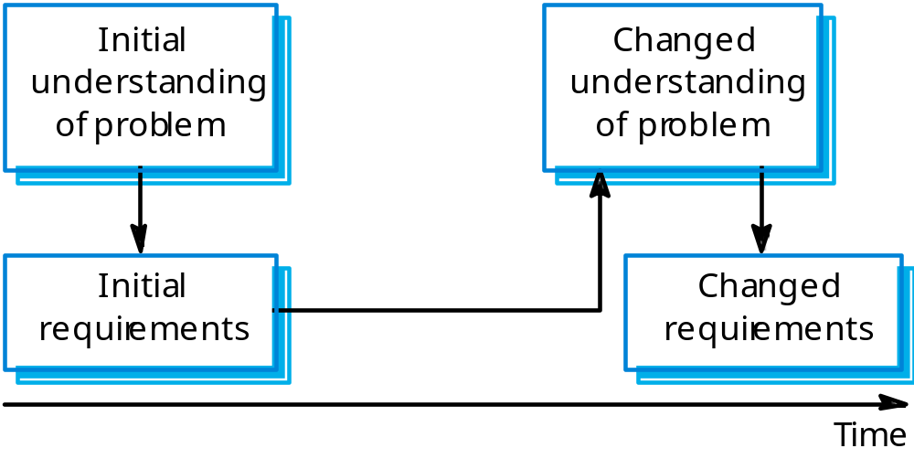
Requirements evolution

Slide 43
Enduring and volatile requirements
From an evolution perspective:
Enduring requirements. Stable requirements derived from the core activity of the customer organisation. E.g. a hospital will always have doctors, nurses, etc. May be derived from domain models
Volatile requirements. Requirements which change during development or when the system is in use. In a hospital, requirements derived from health-care policy

Slide 44
Requirements management planning
During the requirements engineering process, you have to plan:
  Requirements identification
    How requirements are individually identified;
  A change management process
    The process followed when analysing a requirements change;
  Traceability policies
    The amount of information about requirements relationships that is maintained;
  CASE tool support
    The tool support required to help manage requirements change;

Slide 45
Traceability
Traceability is concerned with the relationships between requirements, their sources and the system design
Source traceability
  Links from requirements to stakeholders who proposed these requirements;
Requirements traceability
  Links between dependent requirements;
Design traceability
  Links from the requirements to the design;

Slide 46
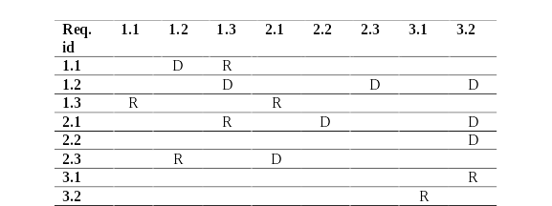
A traceability matrix
They become unwieldy and expensive to maintain for large systems with many requirements

Slide 47
CASE tool support
Requirements storage
  Requirements should be managed in a secure, managed data store.
Change management
  The process of change management is a workflow process whose stages can be defined and information flow between these stages partially automated.
Traceability management
  Automated retrieval of the links between requirements.
Notes:
IBM Rational Requisite Pro

Slide 48
Requirements change management
Should apply to all proposed changes to the requirements.
Principal stages
  Problem analysis. Discuss requirements problem and propose change;
  Change analysis and costing. Assess effects of change on other requirements;
  Change implementation. Modify requirements document and other documents to reflect change.

Slide 49
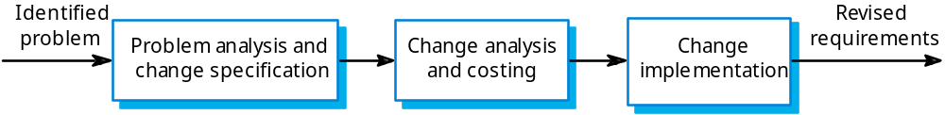
Change management

Slide 50
Key points
The requirements engineering process includes a feasibility study, requirements elicitation and analysis, requirements specification and requirements management.
Requirements elicitation and analysis is iterative involving domain understanding, requirements collection, classification, structuring, prioritisation and validation.
Systems have multiple stakeholders with different requirements.

Slide 51
Key points (continued)
Requirements validation is concerned with checks for validity, consistency, completeness, realism and verifiability.
Business changes inevitably lead to changing requirements.
Requirements management includes planning and change management.

